Slide 1
KGS Hackathon 2019 Use Case 2: Smart Auditor By: Bits and Bytes
Sep 16, 2019

Slide 2
Agenda of Presentation
Problem Statement and Design Overview
Data Extraction, Cleaning and Pre-Processing: Web Scrapping and Data Classification.
Insights, Analysis and AI Module: Trend analysis, ARIMA and Text summarization
Demo of Live Solution: Running the live code and UI
Front End UI, Output and Future Scope: Python Flask, Twillio and Alexa and Future scopes

Slide 3
Problem Statement & Design Overview

Slide 4
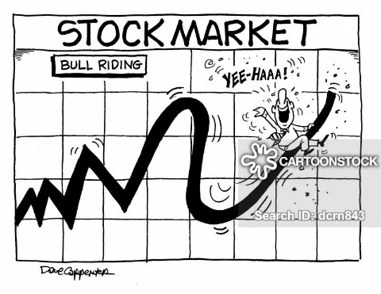





Data Analysis
Auditors
Company Trends
Financial Reports

Slide 5
Business websites
Web Application
SMS Notification: Twilio
Read Out Summary: Play Sound
Alexa Skill
News Articles
Web Scrapping
Text Summarization
Rule Based Classification
Data Analysis: Word Cloud
Alexa
Architecture Capabilities
Sentiment Analysis
Time Series: ARIMA analysis
SMS Notification
Scalability
Stock Price (Yahoo Finance)
Stock price trends
Centralization
Output integration with Python Flask
Google trends (PyTrends)
Google Trends data analysis
Javascript and CSS

Slide 6
Data Extraction, Cleaning and Pre-Processing

Slide 7
Data Extraction and Preprocessing
Data is one of the most valuable resources today’s businesses have. There is a example that more information you have about your customers, the better you can understand their needs and interests.
Our tool collects data from heterogeneous web resources, news papers such as economictimes.indiatimes.com, reuters.com, ndtv.com, thehindubussinessline.com, moneycontrol.com, the hindu.com dynamically and stores for processing.
We are filtering “primary data” by scrapping unnecessary information which it has recorded.

Slide 8
News articles Classification
Once the enormous information about a specific company it is difficult to know their areas of growth.
As the data is completely unstructured We have used bag of words to initially classify scrapped data and stored it with their respective labels.
As labeled data is available from several clients we created an algorithm using Multi class text classification to investigate data and achieved best results post classification to reinforce it learning process

Slide 9
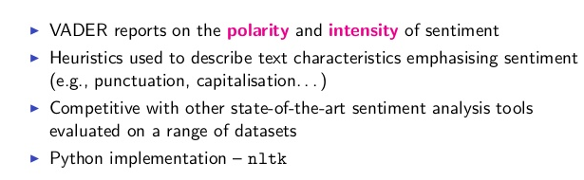
News Sentiment analysis
VADER sentiment analysis relies on a dictionary which maps lexical features to emotion intensities called sentiment scores.
The sentiment score of a text can be obtained by summing up the intensity of each word in the text.
We have used VADER (Valence Aware Dictionary and sentiment Reasoner) is a lexicon and rule-based sentiment analysis tool that is specifically attuned to sentiments expressed in social media, and works well on texts from other domain to analyze its sentiment and visualize inform of charts and graph

Slide 10
Insights, Analytics and AI Module

Slide 11
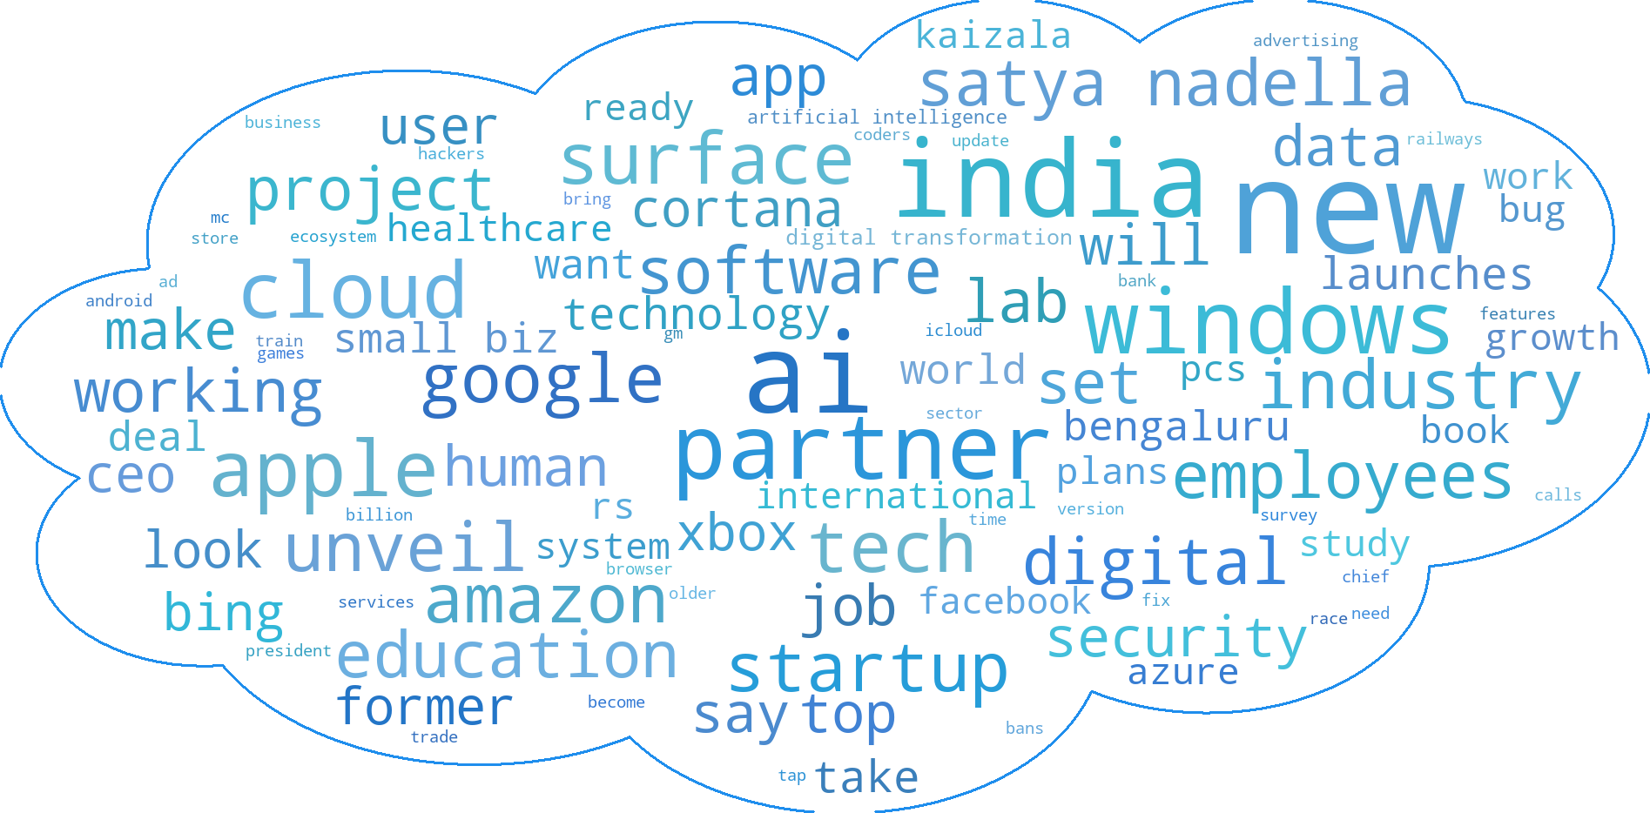
Data Analysis: Word Cloud

Slide 12
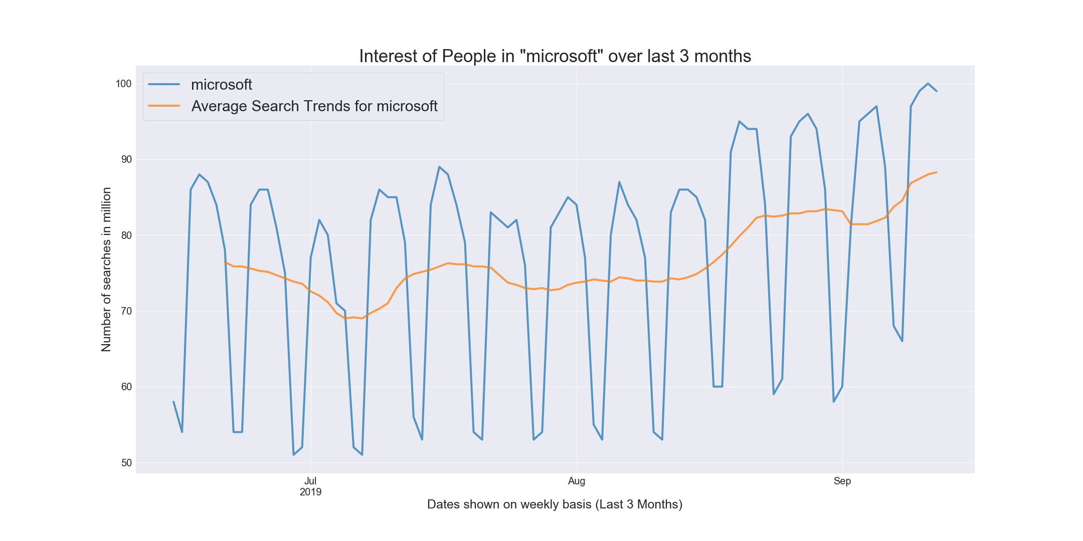
Trend Analysis: Google Trends API

Slide 13
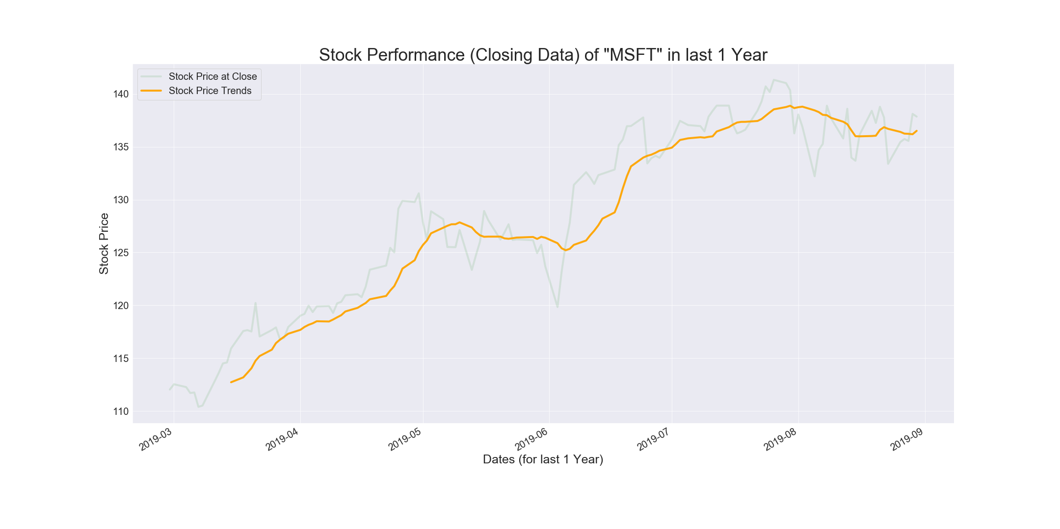
Stock Price Analysis: Yahoo Finance API

Slide 14
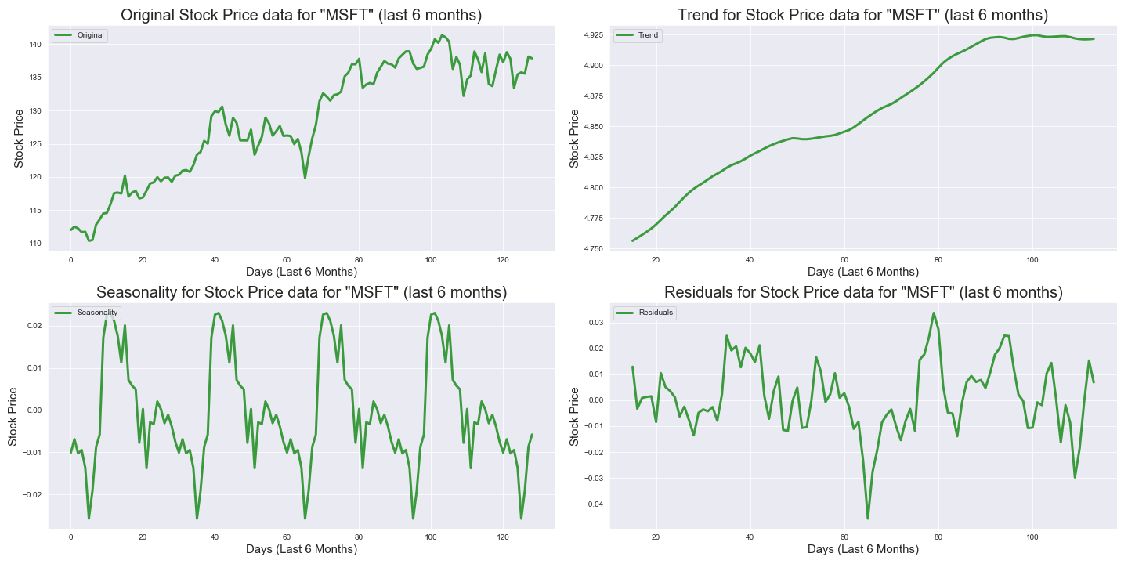
Stock Price Forecasting: Time Series forecasting Part 1 : Trends, Seasonality and Residual Analysis (seasonal_decompose)

Slide 15
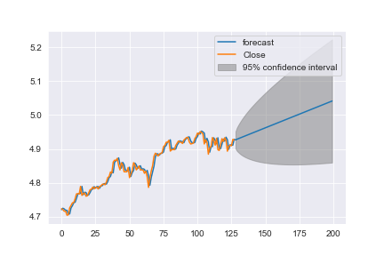
Stock Price Forecasting: Time Series forecasting Part 2 : Stationarity, ARIMA(2,1,0) and Forecasting
Checking Stationarity : ADF Test (Augmented Dickey Fuller)
Differencing of Series to make it stationery.
ACF and PACF Calculation (q and p value) To make code generic across all clients we are using p=2,d=1,q=0
Stock Price prediction and Opinion like:
“Company seems to be doing good in terms of revenue and stock price, expecting increase in stock price by 7.19% in near future.”

Slide 16
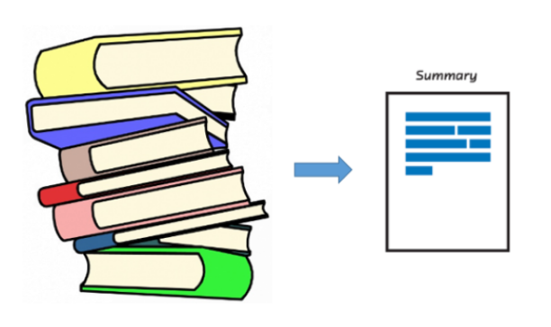
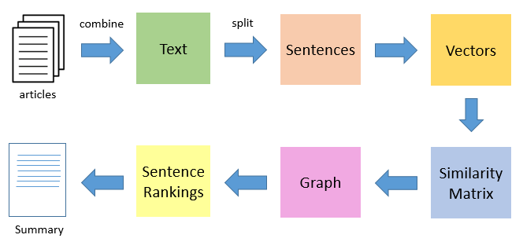
Text Summarization: Genism
The gensim implementation is based on the popular “TextRank” algorithm
TextRank is an algorithm inspired by PageRank, which often used in keyword extraction and text summarization

Slide 17
Demo of Live Solution

Slide 18
Front End UI, Output and Future Scopes

Slide 19
Application - User Interface – PART 1
WEB APPLICATION – FLASK
SUMMARY ON MOBILE – REAL TIME SMS NOTIFICATION
SUMMARY ON VOICE
ALEXA SKILL - DEPLOYED IN AWS
CLIENT DETAIL
COMPETITOR ANALYTICS

Slide 20
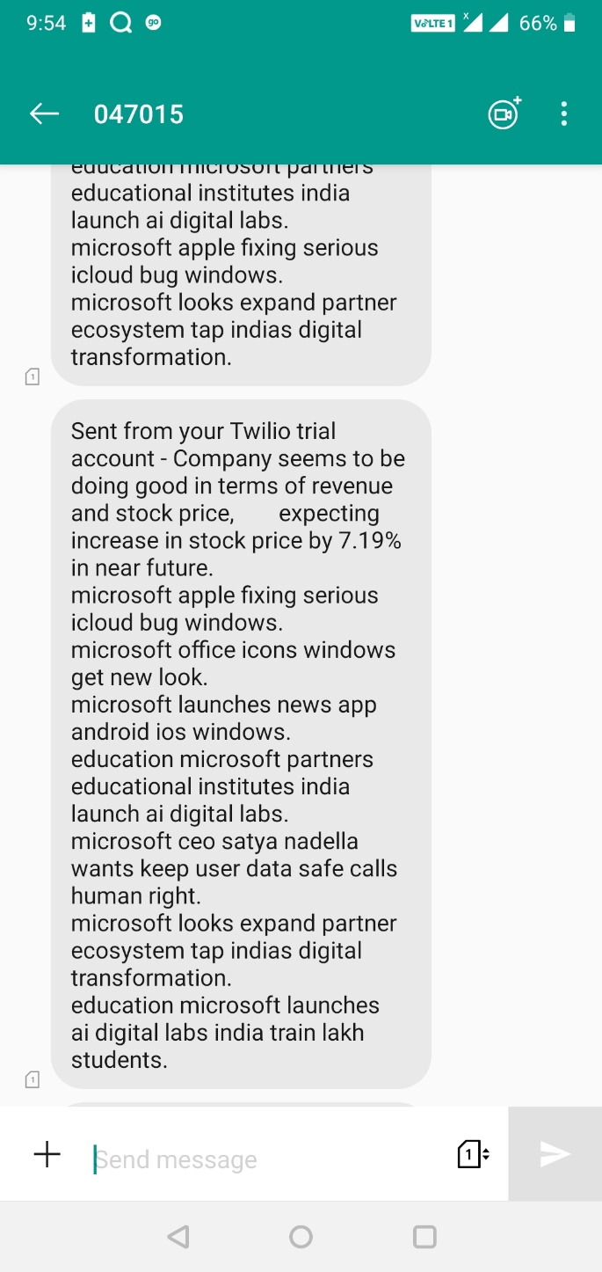
SMS AND VOICE- Web application integration
TWILIO
PAY AS YOU GO
INTERNATIONAL AND LOCAL NUMBER $0.0075 PER SMS
SUMMARY ON VOICE

Slide 21


Application - ALEXA SKILL
ALEXA SKILL
Alexa skill kit
Python 3.6
AWS Lambda function – Free tier

Slide 22
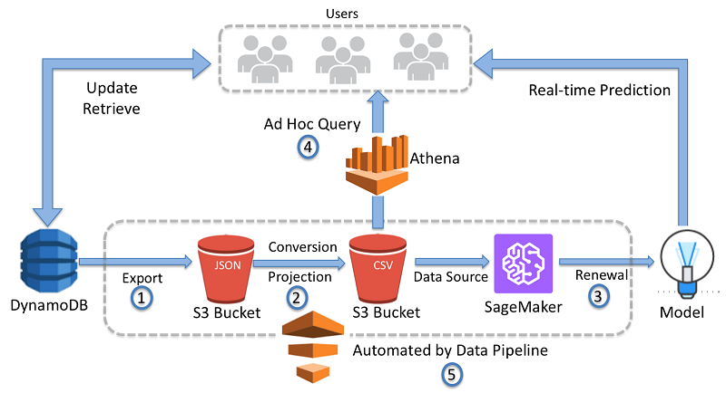

ALEXA COMPETITOR ANALYTICS – FUTURE SCOPE
SA WEB APPLICATION

Slide 23
Thank you

Slide 24
kpmg.com/socialmedia
© 2019 KPMG Global Delivery Center Private Limited, a company incorporated under the laws of India and a member of KPMG network of independent firms. All rights reserved. The KPMG name and logo are registered trademarks or trademarks of KPMG International.

